Slide 1

CSCE 121
More Object Examples Stacks & Queues
Dr. Tim McGuire
Some of the material and images from Bradley Kjell, Central Connecticut State University and Tony Gaddis, Haywood Community College

Slide 2
Introduction to the Stack Abstract Data Type
Stack: a LIFO (last in, first out) data structure
Examples:
plates in a cafeteria
return addresses for function calls
Implementation:
static: fixed size, implemented as array
dynamic: variable size, implemented as linked list

Slide 3
Developing an ADT During the Design of a Solution
A stack
Last-in, first-out (LIFO) property
The last item placed on the stack will be the first item removed
Analogy
A stack of dishes in a cafeteria
Example:
Stack of cafeteria dishes

Slide 4
Stack Operations and Functions
Operations:
push: add a value onto the top of the stack
pop: remove a value from the top of the stack
Functions:
isFull: true if the stack is currently full, i.e., has no more space to hold additional elements
isEmpty: true if the stack currently contains no elements

Slide 5
Stack Operations - Example
A stack that can hold char values:
K
E
G
K
E
E
push('E');
push('K');
push('G');

Slide 6
Stack Operations - Example
A stack that can hold char values:
E
K
E
pop();
(remove G)
pop();
(remove K)
pop();
(remove E)

Slide 7
UML Diagram for the class Stack
Stack
+Stack()
+isFull() : boolean
+isEmpty() : boolean
+push(newEntry : StackItemType)
+pop() : StackItemType

Slide 8
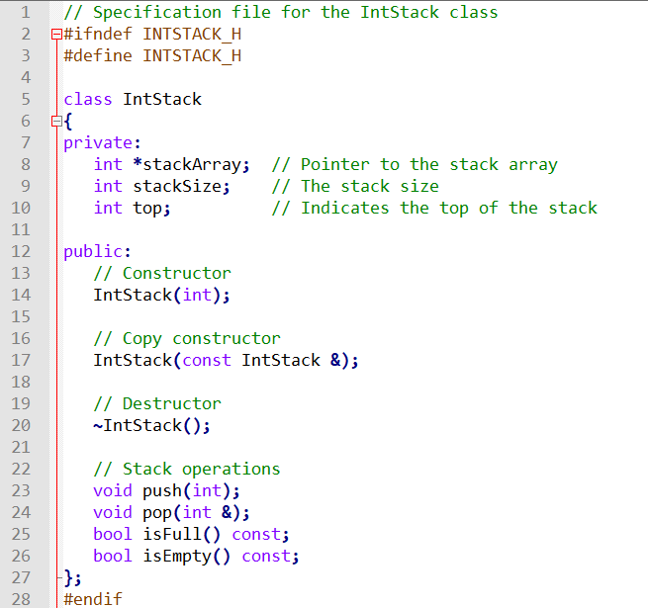
See: IntStack.h
IntStack.cpp IntStackDemo.cpp

Slide 9
Templated Stacks
See Stack.h, TemplatedStackDemo.cpp

Slide 10
Dynamic Stacks

Slide 11
Dynamic Stacks
Grow and shrink as necessary
Can't ever be full as long as memory is available
Implemented as a linked list

Slide 12
Implementing a Stack
Programmers can program their own routines to implement stack functions
See DynIntStack class for an example.
A templated class example is in DynamicStack.h
Can also use the implementation of stack available in the STL

Slide 13
The STL stack Container

Slide 14
The STL stack container
Stack template can be implemented as a vector, a linked list, or a deque
Implements push, pop, and empty member functions
Implements other member functions:
size: number of elements on the stack
top: reference to element on top of the stack

Slide 15
Defining a stack
Defining a stack of chars, named cstack, implemented using a vector:
stack< char, vector<char>> cstack;
implemented using a list:
stack< char, list<char>> cstack;
implemented using a deque:
stack< char > cstack;

Slide 16
See StackSTLdemo.cpp for an example

Slide 17
Introduction to the Queue ADT

Slide 18
Introduction to the Queue ADT
Queue: a FIFO (first in, first out) data structure.
Examples:
people in line at the theatre box office
print jobs sent to a printer
Implementation:
static: fixed size, implemented as array
dynamic: variable size, implemented as linked list

Slide 19
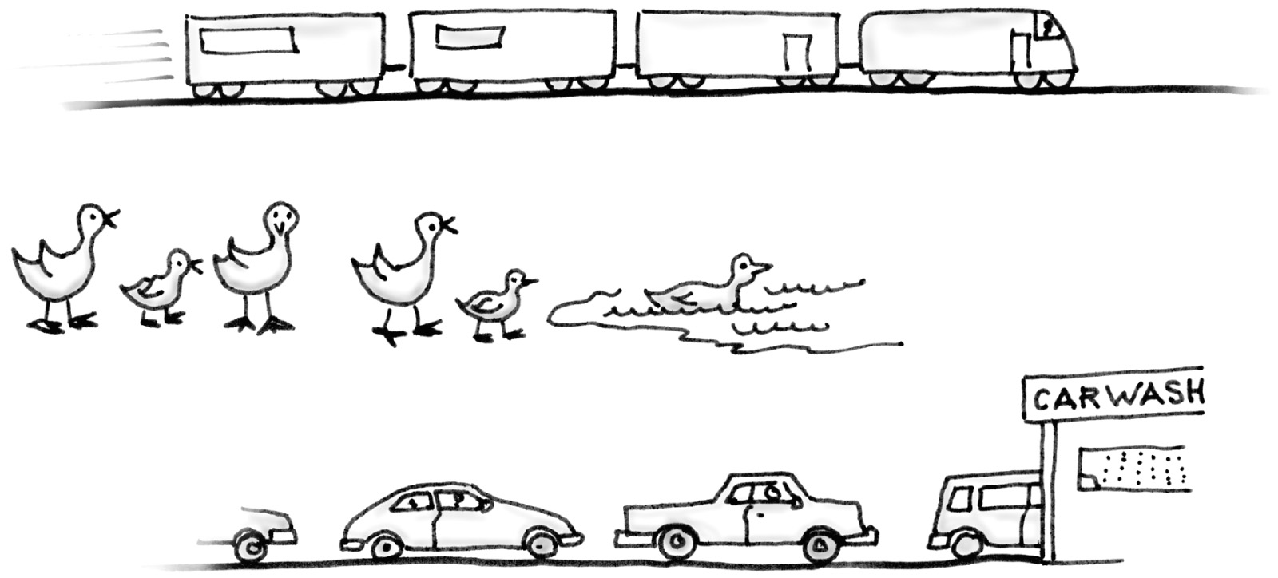
Some everyday queues.

Slide 20
The Abstract Data Type Queue
Queues
Are appropriate for many real-world situations
Example: A line to buy a movie ticket
Have applications in computer science
Example: A request to print a document
A simulation
A study to see how to reduce the wait involved in an application

Slide 21
Queue Locations and Operations
rear: position where elements are added
front: position from which elements are removed
enqueue: add an element to the rear of the queue
dequeue: remove an element from the front of a queue

Slide 22
An Array-Based Implementation (1st Attempt)
A naive array-based implementation of a queue;
rightward drift can cause the queue to appear full

Slide 23
An Array-Based Implementation (2nd Attempt)
A circular array eliminates the problem of rightward drift
A circular implementation of a queue

Slide 24
An Array-Based Implementation
The effect of some operations of the queue

Slide 25
A problem with the circular array implementation
front and back cannot be used to distinguish between queue-full and queue-empty conditions
b) back catches up to front when the queue becomes full
a) front passes back when the queue becomes empty

Slide 26
Array-based Queue (3rd and Final Attempt)
Use an array of size MAX_QUEUE in a circular fashion
Three variables keep track of the front and rear
f index of the front element
r index immediately past the rear element
n number of items in the queue
normal configuration
Q
0
1
2
f
r
wrapped-around configuration
Q
0
1
2
r
f

Slide 27
Contents of IntQueue.h 1 // Specification file for the IntQueue class 2 #ifndef INTQUEUE_H 3 #define INTQUEUE_H 4 5 class IntQueue 6 { 7 private: 8 int *queueArray; // Points to the queue array 9 int queueSize; // The queue size 10 int front; // Subscript of the queue front 11 int rear; // Subscript of the queue rear 12 int numItems; // Number of items in the queue

Slide 28
Contents of IntQueue.h
(Continued)
13 public: 14 // Constructor 15 IntQueue(int); 16 17 // Copy constructor 18 IntQueue(const IntQueue &); 19 20 // Destructor 21 ~IntQueue(); 22 23 // Queue operations 24 void enqueue(int); 25 void dequeue(int &); 26 bool isEmpty() const; 27 bool isFull() const; 28 void clear(); 29 }; 30 #endif
(See IntQueue.cpp for the implementation)

Slide 29
Dynamic Queues

Slide 30
Dynamic Queues
Like a stack, a queue can be implemented using a linked list
Allows dynamic sizing, avoids issue of shifting elements or wrapping indices
null
front
rear

Slide 31
Implementing a Queue
Programmers can program their own routines to implement queue operations
See the DynIntQue class for an example of a dynamic queue
Can also use the implementation of queue and dequeue available in the STL

Slide 32
The STL deque and queue Containers

Slide 33
The STL deque and queue Containers
deque: a double-ended queue. Has member functions to enqueue (push_back) and dequeue (pop_front)
queue: container ADT that can be used to provide queue as a vector, list, or deque. Has member functions to enque (push) and dequeue (pop)

Slide 34
Defining a queue
Defining a queue of chars, named cQueue, implemented using a deque:
deque<char> cQueue;
implemented using a queue:
queue<char> cQueue;
implemented using a list:
queue<char, list<char>> cQueue;

Slide 35
Bags
For the first example, think about a bag.
Notes:
Start by thinking about a bag -- a gym bag, a grocery bag, whatever your favorite bag is.

Slide 36
Bags
For the first example, think about a bag.
Inside the bag are some numbers.
Notes:
Inside the bag, is a collection of numbers, such as the collection of two fours and an eight shown here.

Slide 37
Initial State of a Bag
When you first begin to use a bag, the bag will be empty.
We count on this to be the initial state of any bag that we use.
THIS BAG
IS
EMPTY.
Notes:
This bag will be our first example of a container class, which is a class where each object can contain a collection of items (such as numbers). One of the important facets of a container class is that each object begins in a known configuration. In the case of a bag, we will count on each bag being initially empty. This is called the initial state of a bag.

Slide 38
Inserting Numbers into a Bag
Numbers may be inserted into a bag.
I AM
PUTTING THE
NUMBER 4
INTO THE
BAG.
Notes:
We will use a fixed collection of operations to manipulate bags. One of the simplest operations that we permit is the action of inserting a new number into a bag.

Slide 39
Inserting Numbers into a Bag
Numbers may be inserted into a bag.
THE 4 IS
IN THE
BAG.
Notes:
In this example, we have inserted the first number -- a four -- into a bag that was previously empty.

Slide 40
Inserting Numbers into a Bag
Numbers may be inserted into a bag.
The bag can hold many numbers.
NOW I'M
PUTTING
ANOTHER
NUMBER IN THE BAG --
AN 8.
Notes:
We can continue inserting new numbers into the bag.

Slide 41
Inserting Numbers into a Bag
Numbers may be inserted into a bag.
The bag can hold many numbers.
THE 8 IS
ALSO IN
THE BAG.
Notes:
Now we have a four and an eight in the bag.

Slide 42
Inserting Numbers into a Bag
Numbers may be inserted into a bag.
The bag can hold many numbers.
We can even insert the same number more than once.
NOW I'M
PUTTING A
SECOND 4
IN THE
BAG.
Notes:
We can even insert a second four into the same bag, as shown here.

Slide 43
Inserting Numbers into a Bag
Numbers may be inserted into a bag.
The bag can hold many numbers.
We can even insert the same number more than once.
NOW THE
BAG HAS
TWO 4'S
AND AN 8..
Notes:
At this point we have two fours and one eight in the bag of numbers.
I want to make a small point on the side: A bag’s behavior is a bit different than a set of numbers. A set is not allowed to have two copies of the same number. But a bag can have many copies of the same number.

Slide 44
Examining a Bag
We may ask about the contents of the bag.
YES,
I HAVE
TWO OF
THEM.
HAVE
YOU GOT
ANY 4's
?
Notes:
At this point, we know the initial state of a bag (it is empty) and we also have one operation (inserting a number). Here is our second bag operation: an ability to query a bag about its contents. In particular, we can ask the bag how many copies does it contain of a given number.
In this example, what would the bag respond if I asked for eights instead of fours. (“Yes, I have one eight.”) What if I ask for tens instead of fours. (“No, I have no tens.”).

Slide 45
Removing a Number from a Bag
We may remove a number from a bag.
THIS
4 IS
OUTTA
HERE!
Notes:
Here is our third bag operation: removing a number from a bag.

Slide 46
Removing a Number from a Bag
We may remove a number from a bag.
But we remove only one number at a time.
ONE 4 IS
GONE, BUT
THE OTHER
4 REMAINS.
Notes:
In this example, I removed one of the fours, but the other four remains intact. Numbers are removed one at a time, so that if there are many fours, and I remove one of them, other fours can remain in the bag.

Slide 47
How Many Numbers
Another operation is to determine how many numbers are in a bag.
IN MY OPINION, THERE ARE TOO MANY NUMBERS.
Notes:
Another operation allows us to find out how many numbers are in the bag at the moment.

Slide 48
Summary of the Bag Operations
A bag can be put in its initial state, which is an empty bag.
Numbers can be inserted into the bag.
You may check how many occurrences of a certain number are in the bag.
Numbers can be removed from the bag.
You can check how many numbers are in the bag.
Notes:
We have talked about four bag operations, but we actually have five since the process of putting a bag into its initial state counts as an operation. This slide just summarizes the five bag operations. By the way, which of these five operations is likely to be implemented via the bag constructor?
...
At this point, the bag is truly abstract, since we haven’t decided how the bag will be implemented. Nevertheless, we still have a good idea of how a bag might be used to solve various problems.
Note: At this point, you might pause the lecture to demonstrate how a paper bag can be used to remember the ages of several students in the class. Start by initializing the bag, then insert several students’ ages, make a few queries about the bag, and finally remove the ages. This is a good place to point out that additional bag operations might be useful, such as an operation of combining two bags. The example bag in Section 3.1 does have some additional operations.

Slide 49
A Quiz
Suppose that a Mysterious Benefactor provides you with the bag class, but you are only permitted to read the documentation in the header file. You cannot read the class definition or implementation file. Can you write a program that uses the bag data type ?
Yes I can.
No. Not unless I see the class declaration for the bag.
No. I need to see the class declaration for the bag , and also see the implementation file.
Notes:
Time for a quiz . . .

Slide 50
A Quiz
Suppose that a Mysterious Benefactor provides you with the bag class, but you are only permitted to read the documentation in the header file. You cannot read the class definition or implementation file. Can you write a program that uses the bag data type ?
Yes I can.
You know the name of the new data type, which is enough for you to declare bag variables. You also know the headings and specifications of each of the operations.
Notes:
We’ll see this concept over and over again. In order to use something, you don’t need to know implementation details -- and, in fact, your thinking is usually clearer if implementation details remain hidden.
By the way, a sample program using a bag is given in Section 3.1 of the text, and this program actually appears before the implementation details of the bag class.

Slide 51
Implementation Details
The entries of a bag will be stored in the front part of an array, as shown in this example.
[ 0 ]
[1]
[ 2 ]
[ 3 ]
[ 4 ]
[ 5 ]
. . .
4
8
4
An array of integers
We don't care what's in
this part of the array.
Notes:
Just to finish things off, let’s look at some details of how the bag class could be implemented. This isn’t the only way to implement the class, but it is a simple approach.
The plan is to store the entries of a bag in the front part of an array, sometimes called a partially-filled array.
For example, if we have an array that contains two fours and an eight, then we would place those three numbers in the first three components of an array. We don’t care what appears beyond those first three components.

Slide 52
Implementation Details
The entries may appear in any order. This represents the same bag as the previous one. . .
[ 0 ]
[1]
[ 2 ]
[ 3 ]
[ 4 ]
[ 5 ]
. . .
4
4
8
An array of integers
We don't care what's in
this part of the array.
Notes:
We also don’t care what order the entries appear in. We might have both fours first . . .

Slide 53
Implementation Details
. . . and this also represents the same bag.
[ 0 ]
[1]
[ 2 ]
[ 3 ]
[ 4 ]
[ 5 ]
. . .
4
4
8
An array of integers
We don't care what's in
this part of the array.
Notes:
. . . or we might have the eight first.

Slide 54
Implementation Details
We also need to keep track of how many numbers are in the bag.
3
An integer to keep
track of the bag's size
[ 0 ]
[1]
[ 2 ]
[ 3 ]
[ 4 ]
[ 5 ]
. . .
8
4
4
An array of integers
We don't care what's in
this part of the array.
Notes:
There is one more item that we do need to keep track of, and that’s the total number of entries in the bag. For this example, the total number of entries in the bag is three.
What would go wrong if we didn’t keep track of this number? Answer: We wouldn’t know what part of the array was being used, and what part of the array was just garbage.
Another question: How would an empty bag be represented? Answer: The bag’s size is zero, and the entire array may be garbage since we are not using any of the array.

Slide 55
An Exercise
Use these ideas to write a list of private member variables could implement the bag class. You should have two member variables. Make the bag capable of holding up to 20 integers.
You have 60 seconds
to write the declaration.
Notes:
Time for another quiz . . .

Slide 56
An Exercise
One solution:
class bag
{
public:
...
private:
int data[20];
size_t count;
};
Notes:
This is not the only solution. You might have used different names for the two private member variables. The important idea is that a private member variable can be an array.
There’s at least one other facet that we should improve. The number 20 is somewhat arbitrary. I might want a bag with a capacity of 200 or 2000 or even 20000. In order to make it clear that the capacity can be easily changed, we should declare the capacity as a constant in the public portion of the bag, like this...

Slide 57
An Exercise
A more flexible solution:
class bag
{
public:
static const size_t CAPACITY = 20;
...
private:
int data[CAPACITY];
size_t count;
};
Notes:
The definition “static const size_t CAPACITY = 20” defines a number called CAPACITY that can be used anywhere within the bag implementation.
The keyword static means that all bags have the same CAPACITY.
The keyword const means that this number cannot change while a program is running (although we could change it and recompile).
The constant is declared with all capital letters; this isn’t a requirement in C++, but most C++ programmers follow the practice of using capitals for constants’ names.
Within a program, you can declare a bag b, and refer to the constant as b.CAPACITY.

Slide 58
An Example of Calling Insert
void bag::insert(int new_entry)
Before calling insert, we
might have this bag b:
[ 0 ]
[ 1 ]
[2]
. . .
8
4
b.data
2
b.count
Notes:
Now that we know about the implementation details of the bag member variables, let’s look at an example of calling bag::insert. In the example, we start with the bag shown here . . .

Slide 59
An Example of Calling Insert
void bag::insert(int new_entry)
void bag::insert(int new_entry)
We make a function call
b.insert(17)
[ 0 ]
[ 1 ]
[2]
. . .
What values will be in
b.data and b.count
after the member
function finishes ?
8
4
b.data
2
b.count
Notes:
. . . and we call bag::insert to insert the number 17.
What will be the values of b.data and b.count after the insertion?

Slide 60
An Example of Calling Insert
void bag::insert(int new_entry)
void bag::insert(int new_entry)
After calling b.insert(17),
we will have this bag b:
[ 0 ]
[ 1 ]
[2]
. . .
[ 0 ]
[1]
[ 2 ]
. . .
8
4
8
4
17
b.data
2
3
b.count
Notes:
We have added the new number, 17, to the next spot in the array; and we have incremented b.count by one to indicate that we are now using one more spot in the array.

